Slide 1

FERRASAGE
.com
- From insight to impact -

Slide 2
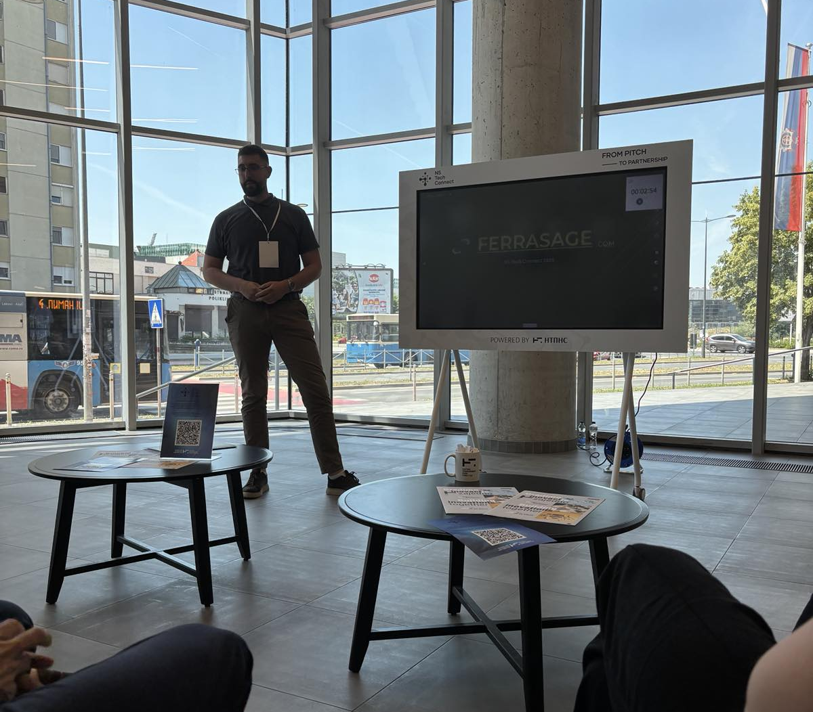


- About us -
Ferrasage as an advanced magnetics and electrification architecture company born from deep automotive engineering roots. We combine technological expertise in the development of magnetics and system architecture that enables the deployment of green energies and the creation of an independent energy infrastructure
Collaborating with agile startups to push boundaries:
Member of Science and Technology Park ecosystem:
NTP Novi Sad — Naučno-tehnološki park
FERRASAGE

Slide 3
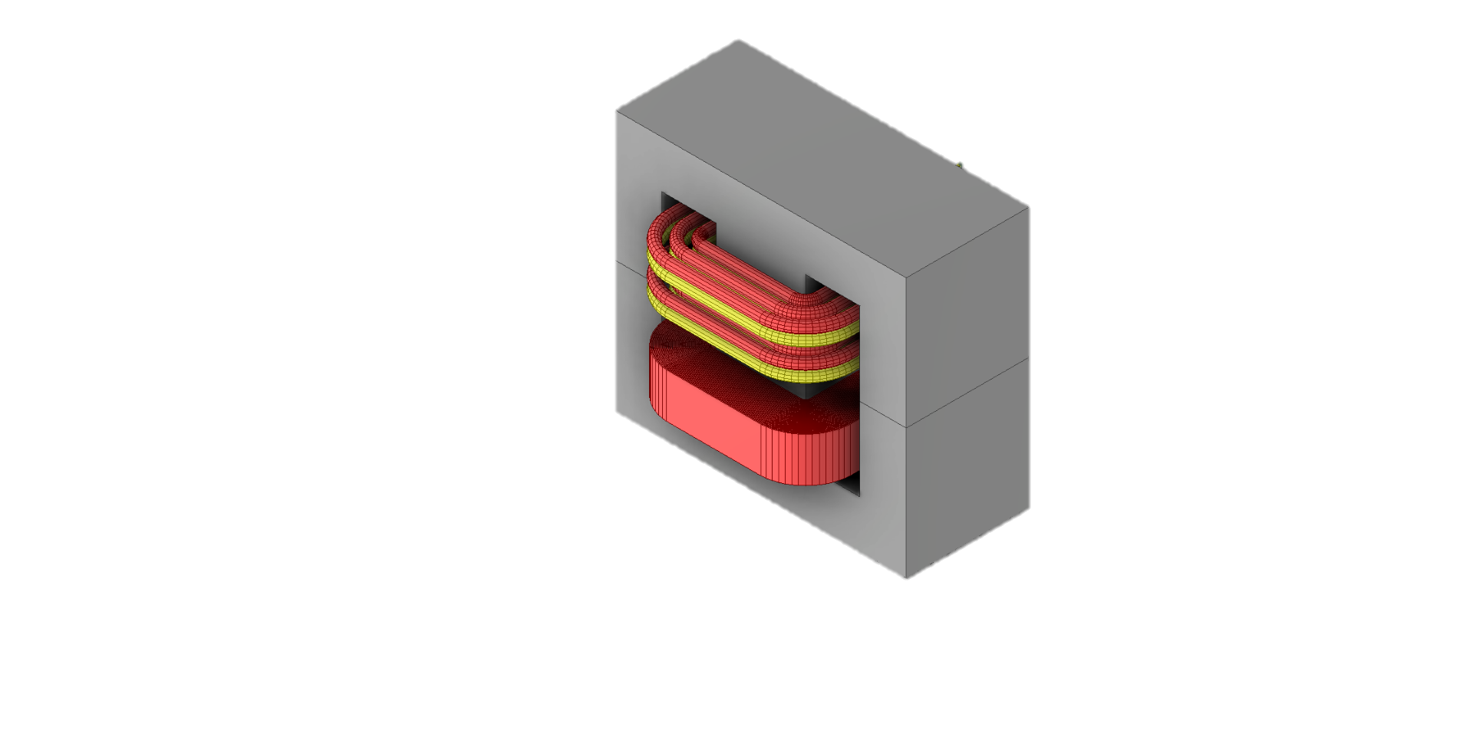
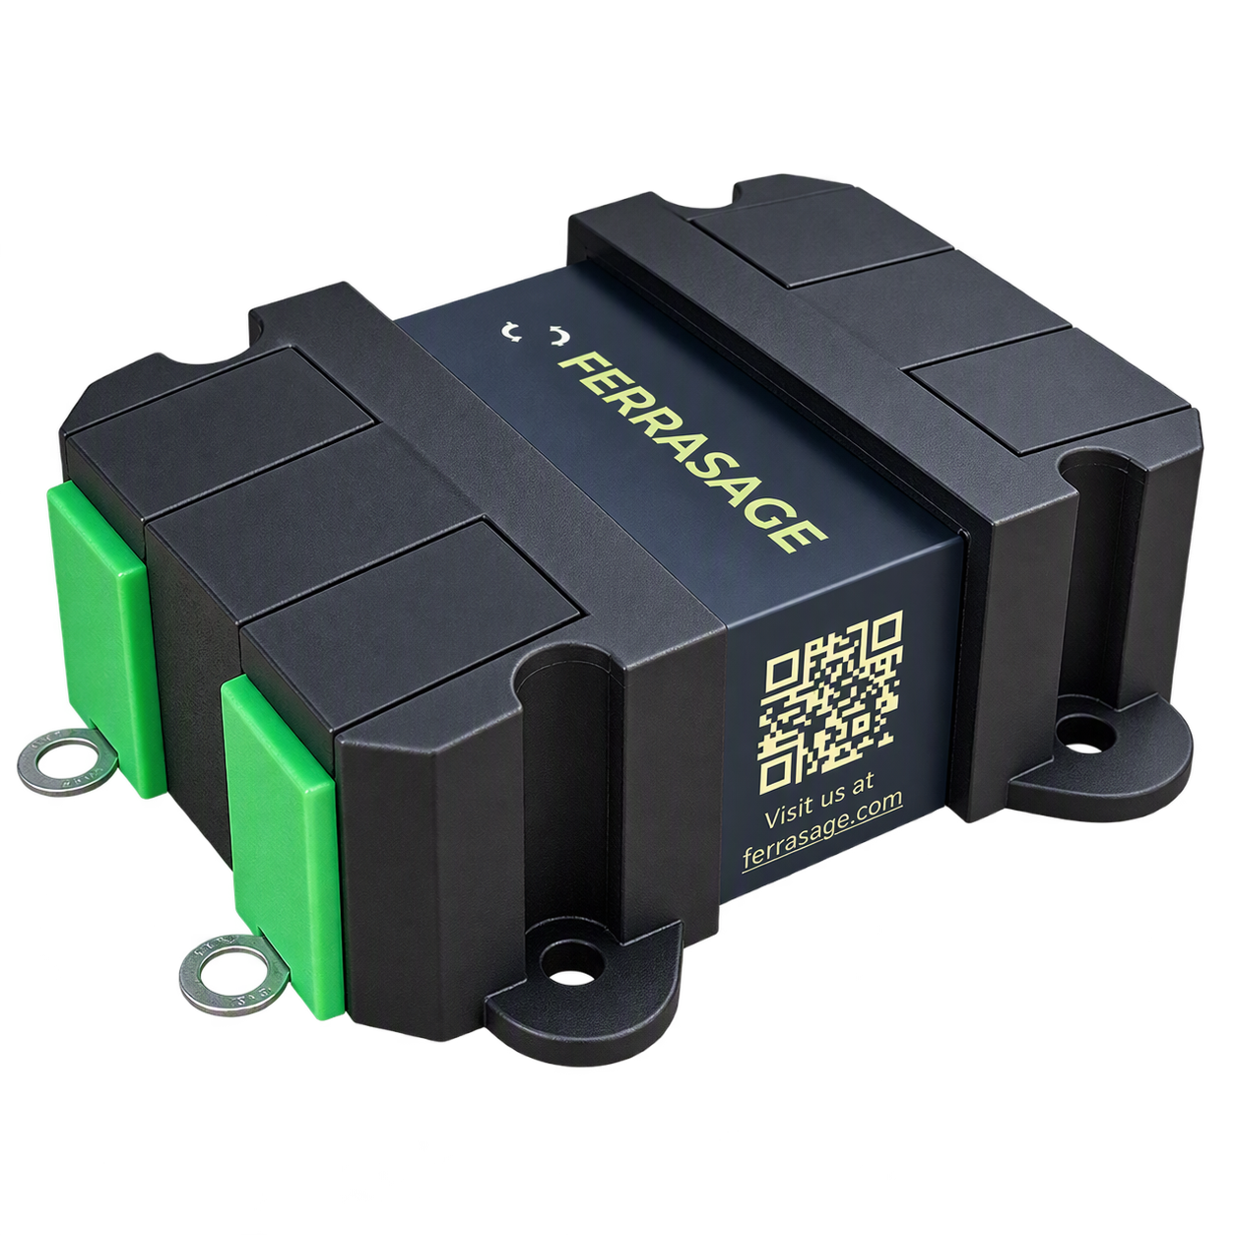
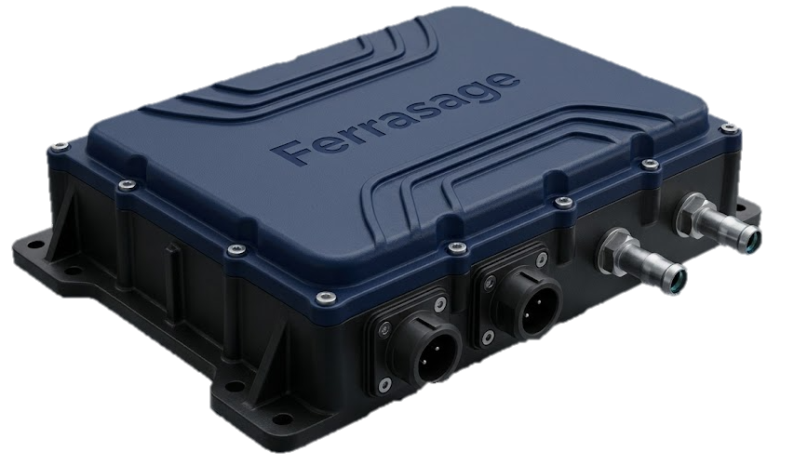
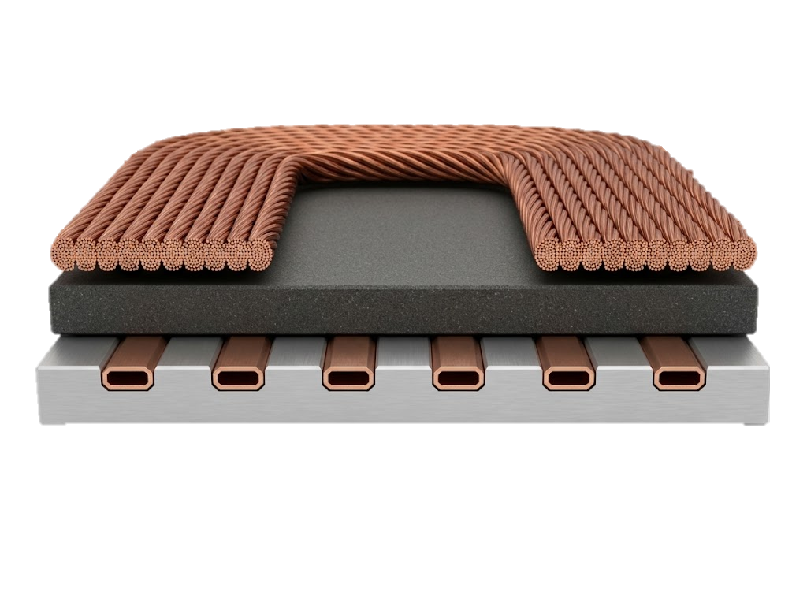
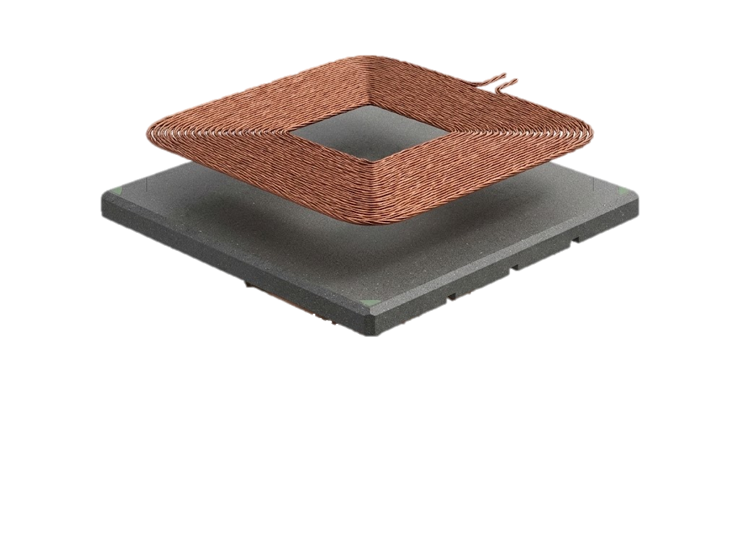
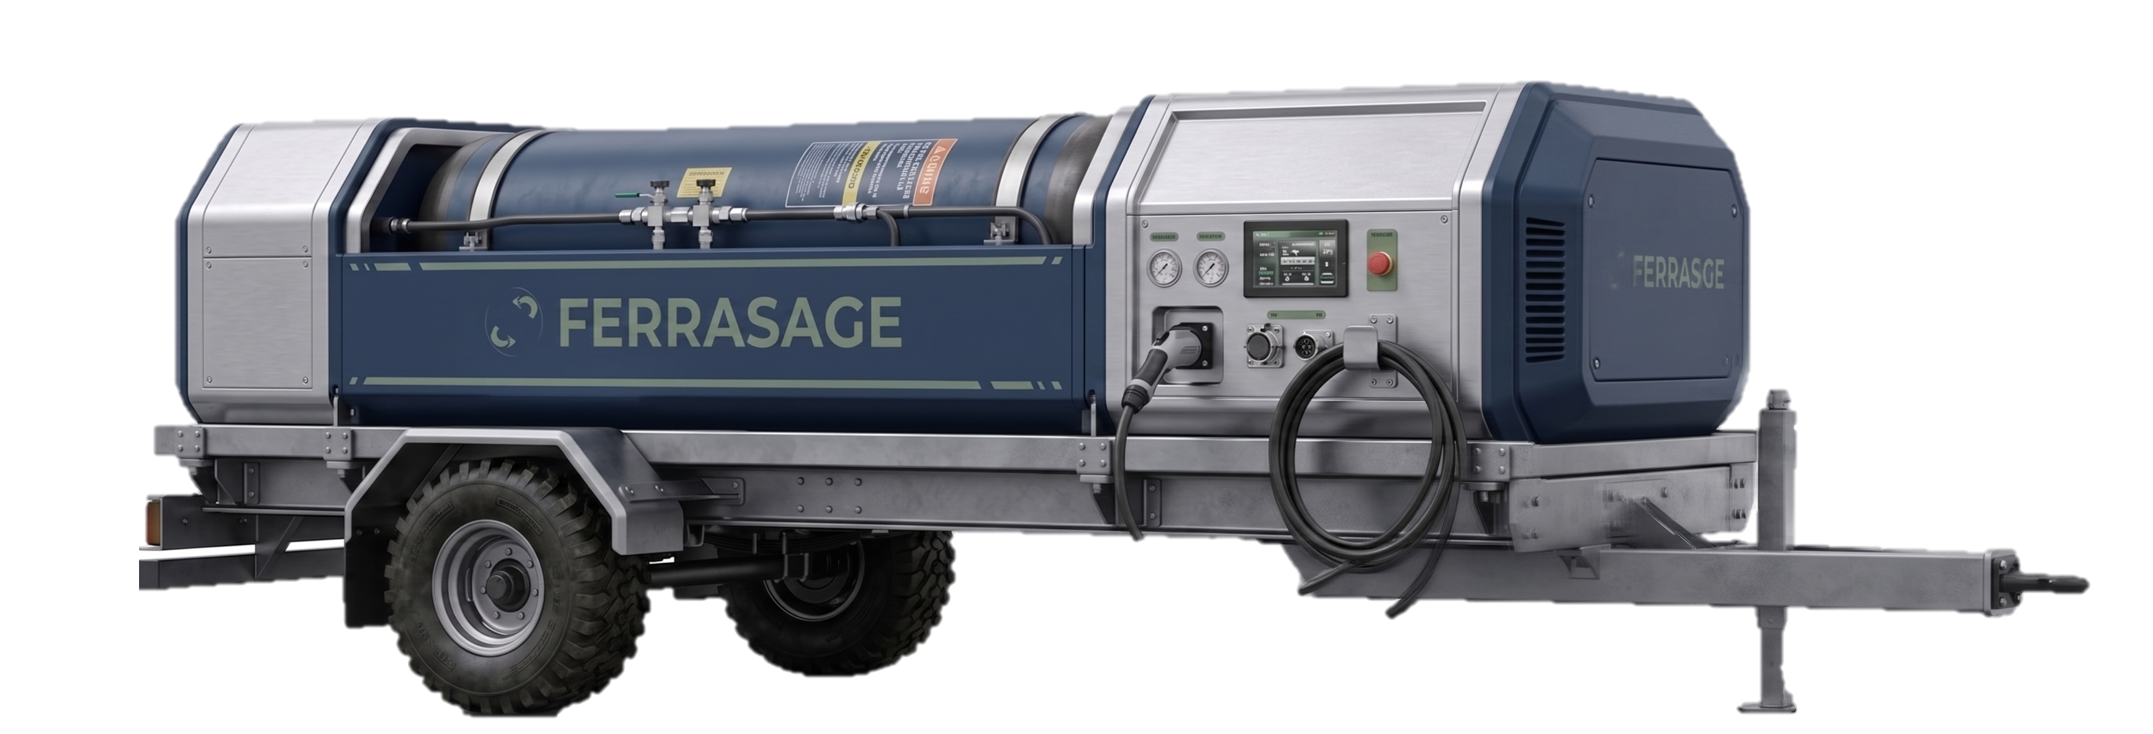
- Active projects -
- Our innovative Concepts -
Planar Transformer with External Leakage Inductance
Hybrid Litz/Foil Transformer
3.6kW
48V/800V
100kHz
1kW Inductive Wireless Power Transfer Coil antenna with integrated cooling of OBC converter
100kW Hydrogen Fuel Cell DC/DC
Mobile Hydrogen Charging station
DC link integrated Hybrid CM/DM EMC filter for Tier 1 Asian Automotive supplier

Slide 4
- Our Services -
Magnetics Component ODM
End-2-End Design service
Simulation expertise
Mechanical design
Prototype production
Component industrialisation
EMC Expert Consultancy
System analysis and risk prediction
Filter technology selection and dimensioning
System integration
Validation support and debugging
System Engineering
Power electronics architecture
Power core design
System mechanical concept
Supplier management
Project technical leadership
We don't just design components; we architect solutions
FERRASAGE

Slide 5
- THANK YOU -
Visit us at: ferrasage.com
D. Buljovčić
FERRASAGE DOO
Djordja Niksića Johana 33
21000, Novi Sad, Serbia
FERRASAGE

